Slide 1
CHANGE AGENT NETWORK OVERVIEW & STRUCTURE

Slide 2
Change Agent Network Objective
The Change Agent Network (CAN) will help stakeholders move up the change curve by acting in following areas, all of which are crucial to a successful project implementation and transition
Provide employees with ongoing access to information and updates related to the change
Serve as a resource to team members on any question
Direct impacted employees to relevant support resources
Communication
Communicate end user sentiments on change management efforts
Collect employee feedback and share with the project team
Enable faster, more effective and less impactful changes
Change Readiness
Risk
Mitigation
Reduce change resistance by encouraging team members to ask questions
Manage risk by including those who know the business best
Implementation
Support
Act as support to team members and external partners leading up to, during, and after go-live
Complete activities (e.g. training scheduling, etc.) necessary to support initiative deployment

Slide 3
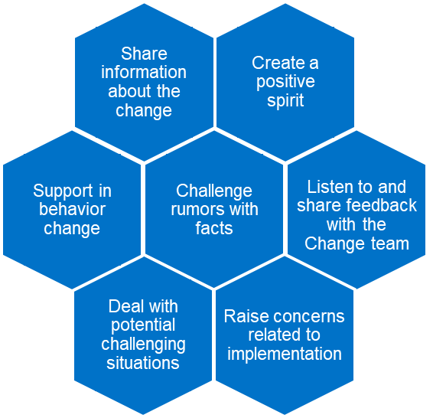
Change Agent Network Overview
An effective Change Agent Network will actively:
Our Success Secret
Networking is not about just connecting people. It's about connecting people with people, people with ideas, and people with opportunities.
Michele Jennae
Purpose
Goal
Benefits
A community of employees and leaders who work with the team to exchange information and support employees through change
Support the projects objectives by championing the vision, encouraging engagement, and providing business support and communicating feedback back to the project.
Active engagement of those most affected by change efforts
Empowerment of staff providing ongoing ‘voice’ to “what works” and “what doesn’t
A regular feedback mechanism
to monitor change capacity

Slide 4
ROI
To accomplish these goals, the Change Agent Network will bring value to the program in the following ways:
Advocacy
Demonstrate buy-in and ownership
Advocate for adoption of the changes among team members
Advice and
Insight
Share lessons learned on what works well and what doesn’t
Raise awareness of possible risks and propose potential solutions
Review and
Feedback
Provide feedback on managing change across all impacted stakeholders
Review and provide feedback on training content and communication materials
Education
and Expertise
Help coach and train others to drive a smooth transition
Lend professional credibility to the project and cascade information to the business
Time Commitment ~ 2hrs a Month

Slide 5
Change Agent Network
The Change Agent Network will focus on representatives whose line of business supports or roles are impacted by organizational changes
Functional Teams
Heavy Users/ Voice of Customer
Name | Function
Name | Region / Function

Slide 6
Engagement Cadence
They key to success of a Change Agent Network is consistent ongoing meetings and touchpoints.
Monthly Meetings
Milestone Specific Touchpoints
Open forum for communication with the network
Communicates change implementation updates with the network
Responds to questions from the network
Identify lessons learned with the network and impact to the business
Documents call to actions and network feedback necessary for escalation
Discuss/Engage Network on project milestone activities to create awareness and their engagement
Communicates engagement activity ideas and successfully implemented activities from the change network
Communicates information learned from call to actions and feedback activities
Supports communication of written implementation updates

