Slide 1
ANALYSIS: CHANGE &
STAKEHOLDER IMPACT

Slide 2

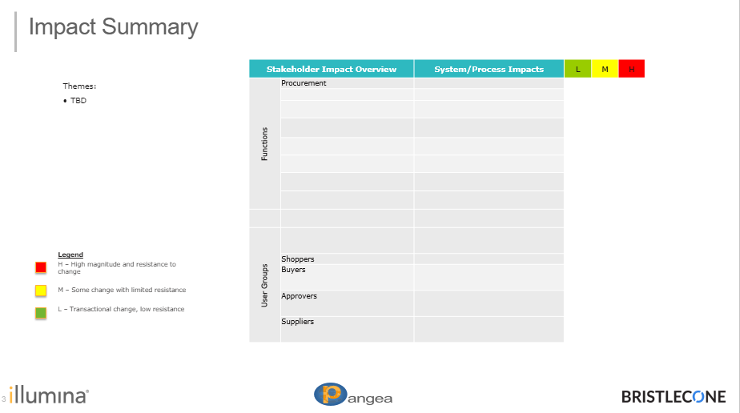
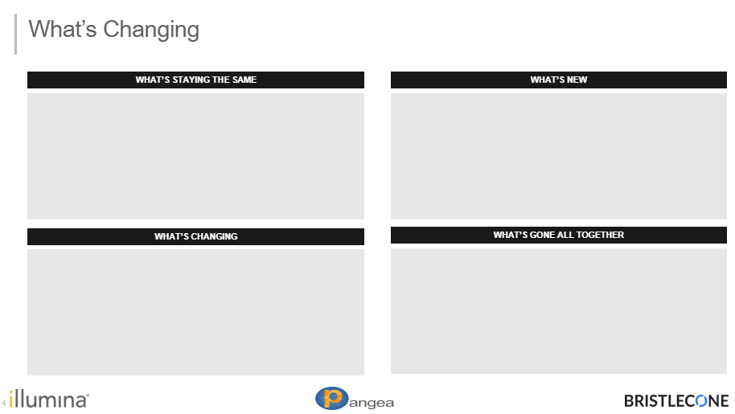
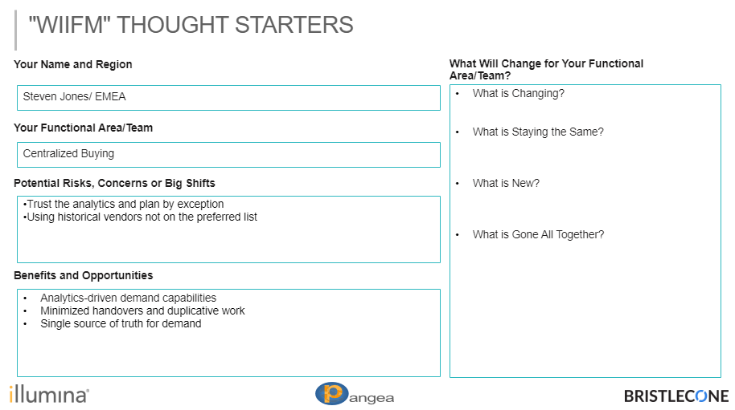
Analysis
WHAT
The Change & Stakeholder Impact approach identifies key stakeholders, their respective level of impact, and the recommended engagement model to drive effective awareness and engagement.
WHO
Change Management meet with stakeholders for to understand unique impacts from transition.
HOW
Outcomes include:
Define the information needs, by audience, based on change impact;
Determine the engagement model by stakeholder;
Create and maintain consistent engagement with key stakeholders, keeping them informed throughout the program;
Deliver tailored messaging based on audience-specific needs; &
Create transparency into program status, progress against key milestones, and issues / risks

Slide 3
Change Overview
Stakeholder Summary
Change Impact
Impacted Orgs:
Impacted Roles:
Size of Impacted Population:
Key Interests/Concerns
  TBD
Key Benefits
  TBD
System & Process | TBD
What’s Changing? | TBD
What Stays The Same? | TBD
What Goes Away? | TBD
Risk & Readiness Assessment
Readiness Criteria |  | Risks
Size of Stakeholder Group |  | TBD
Impact on Core Competencies
Timeframe for Change
Number of Locations
Change to Skill & Behavior
Stakeholder Commitment
Number of Simultaneous Changes

Slide 4
Impact Summary
Stakeholder Impact Overview |  | System/Process Impacts | L | M | H
Functions | HR
 | Finance
 | Technology
 | Procurement
 | Talent Acquisition
User Groups
 | Shoppers
 | Buyers
 | Approvers
 | Suppliers
Themes:
TBD
Legend
H – High magnitude and resistance to change
M – Some change with limited resistance
L – Transactional change, low resistance

Slide 5
What’s Changing (Systems)
WHAT’S STAYING THE SAME
WHAT’S NEW
WHAT’S CHANGING
WHAT’S GONE ALL TOGETHER

Slide 6
Function / Role 1 - Process From / To
System/ Process | Change | Significance of Change | Stop | Continue | Start
1
2
3

Slide 7
Function / Role 2 - Process From / To
System/ Process | Change | Significance of Change | Stop | Continue | Start
1
2
3

Slide 8
Stakeholder Impact Overview
STAKEHOLDER | INTEREST | CONCERNS | CONTEXT / CONSIDERATIONS

Slide 9
"WIIFM" THOUGHT STARTERS
Name and Region
What Will Change for Your Area/Team?
  TBD
Functional Area/Team
Perceived Risks/Concerns/Big Shifts
Perceived Benefits/Opportunities/Suggestions
Risks
TBD
Concerns
TBD
Big Shifts
TBD
  Suggestions/Ask
  TBD
  Additional Feedback

