Slide 1
STAKEHOLDER ENGAGEMENT

Slide 2
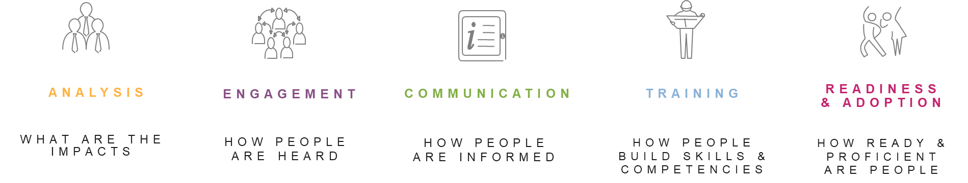
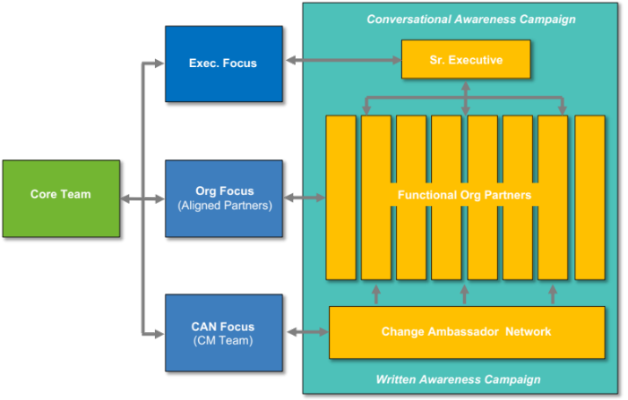
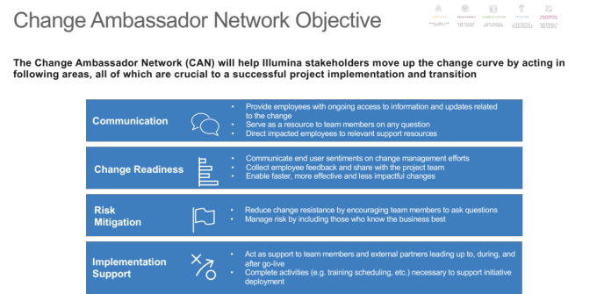
Engagement Summary
OVERVIEW
The Stakeholder Engagement Approach identifies key stakeholders, their respective level of impact, and the recommended engagement model to drive effective transition.
KEY OUTCOMES
Define the information needs, by audience, based on change impact;
Determine the engagement model by stakeholder;
Create and maintain consistent engagement with key stakeholders, keeping them informed throughout the program;
Deliver tailored messaging based on audience-specific needs;
Create transparency into program status, progress against key milestones, and issues / risks

Slide 3
Scale and Definitions
Using the Stakeholder Impact assessment, identify those stakeholders being impacted by the change and their level support - which will determine the owner of each routine, the content to provide, and the frequency for the connection.
Impact by Change
Low | Directly/indirectly impacted by the change. Small changes to processes, skills and knowledge, and/or tools and technologies. May be small changes to job responsibilities as well.
Medium | directly impacted by the change. Likely small to moderate changes to processes, skills and knowledge, and/or tools and technologies. Small or unlikely changes to organization structure, and moderate changes to job responsibilities.
High | Directly impacted by the change. Large changes to processes, skills and knowledge, and tools and technologies. Likely changes to the organization structure and job responsibilities; a moderate mindset change is expected.
Level of Influence
Low | The stakeholder group does not have the potential or ability to significantly enable or block the initiative.
Medium | The stakeholder group has the potential and ability to make the change easier or more difficult.
High | The stakeholder group has the potential and ability to significantly enable or block the initiative (e.g., “pull the plug” on the project).
Level of support
Active Resistor | This person has the ability to change, but is not willing to change.
Passive Resistor | This person does not have the ability to change, and is not willing to change
Follower / Supporter | This person does not have the ability to change, but would be willing to change.
Enthusiast | This person does have the ability to change, and would be willing to change.
Neutral | This person is on the fence about the change.

Slide 4
Engagement Matrix
Conversational Awareness Campaign
Exec. Focus
(Exec)
Sr. Executive
Core Team
Org Focus
(Aligned Partners)
Functional Org Partners
CAN Focus
(CM Team)
Change Ambassador Network
Written Awareness Campaign

Slide 5
Executive Engagement Focus
Engage at the Top to Inform and Request Support
Objective
Inform Senior Executives of the project including potential implications to business operations and risks
Participants
Executives, Regional Leadership, Steering Committee
Vehicles
Standing Meetings / Presentation Materials
One-on-One / Group Engagement
Leave-Behind Collateral / One Pagers
Awareness Campaign
Frequency
Steering Committee – Quarterly
High Level of Impact / Support - Monthly
Awareness Campaign
Exec. Focus
Sr. Executive
Core Team
Org. Focus
Functional Org Partners
CAN Focus
Change Ambassador Network
Awareness Campaign

Slide 6
Engagement Operating Model
Recommended Engagement Ownership, Vehicles, Frequency
Executive Leadership/ Steering Committee
STAKEHOLDER | Routine Owner | Impact/Influence/Support | Content | Vehicle | Frequency
 |  |  | Program milestones / status Issues / risks | Program dashboard Steering Committee meeting | Quarterly As needed
 |  |  | Program milestones / status Issues / risks | Program dashboard Steering Committee meeting Workshops | Bi-weekly As needed
 |  |  |  |  | As needed
 |  |  |  | Email Face to face One-pager Workshops
 |  |  | Significant milestones Issues / risks | Program dashboard Steering Committee meeting | Quarterly As needed
 |  |  |  | Email Face to face One-pager Workshops | Bi-weekly As needed
 |  |  |  | Steering Committee meeting Face to face Workshops

Slide 7
Org Partner Engagement Focus
Engage in the Middle to Manage Direct Org Impacts
Objective
Engage Functional Business Leaders to discuss direct / indirect impacts to their org and potential implications to business operations
Participants
Functional Business Leaders (prioritized)
Process Owners
Vehicles
Standing Meetings / Presentation Materials
One-on-One / Group Engagement / Email
Leave-Behind Collateral / One Pagers
Frequency
Specific to each functional org
At a minimum, one entry touch point, leave-behind collateral, and one exit engagement session
Awareness Campaign
Exec. Focus
Sr. Executive
Core Team
Org. Focus
Functional Org Partners
CAN Focus
Change Ambassador Network
Awareness Campaign

Slide 8
Engagement Operating Model
Recommended Engagement Ownership, Vehicles, Frequency
Functional Organization Partners
Stakeholder / Function | Routine Owner | Impact/Influence/Support | Content | Vehicles | Frequency
 |  |  | Program milestones / status Work stream details Implications to business Issues / risks | Face to Face/ Virtual | Bi-weekly
 |  |  | Program milestones / status Issues / risks Implications to business Messages to cascade | Email Face to Face/Virtual | Monthly
 |  |  | Program milestones/status Work Stream details Issues/risks | Face to Face/Virtual | Bi-weekly
 |  |  | Program milestones/status Work stream details Issues/Risks Regional Implications | Face to Face/Virtual | Monthly

Slide 9
Change Agent Engagement Focus
Engage Key Groups to Extend Reach and Leverage Relationships
Objective
Engage Change Ambassador Network in change topics; equip CAN members with materials to penetrate respective orgs and social networks
Participants
LOB Representatives, Heavy Users, Admins
Program / Transition Mgmt Team
Vehicles
Change Agent Network Meetings / Presentation Materials
Group Engagement
Leave-Behind Collateral / Training Material for Users / One-page Collateral for Leaders
One-Stop-Shop Workspace/Box
Frequency
Monthly
As needed
Awareness Campaign
Exec. Focus
Sr. Executive
Core Team
Org. Focus
Functional Org Partners
CAN Focus
Change Ambassador Network
Awareness Campaign

Slide 10
Change Ambassador Network Objective
The Change Ambassador Network (CAN) will help stakeholders move up the change curve by acting in following areas, all of which are crucial to a successful project implementation and transition
Provide employees with ongoing access to information and updates related to the change
Serve as a resource to team members on any question
Direct impacted employees to relevant support resources
Communication
Communicate end user sentiments on change management efforts
Collect employee feedback and share with the project team
Enable faster, more effective and less impactful changes
Change Readiness
Risk
Mitigation
Reduce change resistance by encouraging team members to ask questions
Manage risk by including those who know the business best
Implementation
Support
Act as support to team members and external partners leading up to, during, and after go-live
Complete activities (e.g. training scheduling, etc.) necessary to support initiative deployment

Slide 11
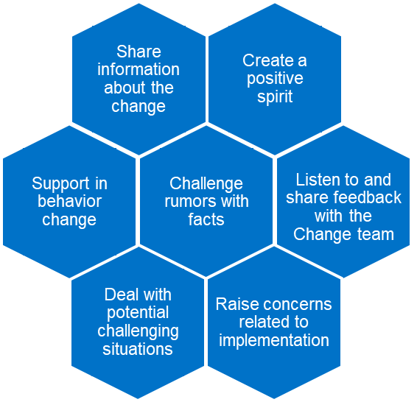
Change Ambassador Network Overview
An effective Change Ambassador Network will actively:
Our Success Secret
Networking is not about just connecting people. It's about connecting people with people, people with ideas, and people with opportunities.
Michele Jennae
Purpose
Goal
Benefits
A community of employees and leaders who work with the team to exchange information and support employees through change
Support the projects objectives by championing the vision, encouraging engagement, and providing business support and communicating feedback back to the project.
Active engagement of those most affected by change efforts
Empowerment of staff providing ongoing ‘voice’ to “what works” and “what doesn’t
A regular feedback mechanism
to monitor change capacity

Slide 12
ROI
To accomplish these goals, the Change Ambassador Network will bring value to the program in the following ways:
Advocacy
Demonstrate buy-in and ownership
Advocate for adoption of the changes among team members
Advice and
Insight
Share lessons learned on what works well and what doesn’t
Raise awareness of possible risks and propose potential solutions
Review and
Feedback
Provide feedback on managing change across all impacted stakeholders
Review and provide feedback on training content and communication materials
Education
and Expertise
Help coach and train others to drive a smooth transition
Lend professional credibility to the project and cascade information to the business
Time Commitment ~ 2hrs a Month

Slide 13
Change Ambassador Network
The Change Ambassador Network will focus on representatives whose line of business supports or roles are impacted by organizational changes
Functional Teams
Heavy Users/ Voice of Customer
Name | Function
Name | Region / Function

Slide 14
Engagement Cadence
They key to success of a Change Network is consistent ongoing meetings and touchpoints.
Monthly Meetings
Milestone Specific Touchpoints
Open forum for communication with the network
Communicates change implementation updates with the network
Responds to questions from the network
Identify lessons learned with the network and impact to the business
Documents call to actions and network feedback necessary for escalation
Discuss/Engage Network on project milestone activities to create awareness and their engagement
Communicates engagement activity ideas and successfully implemented activities from the change network
Communicates information learned from call to actions and feedback activities
Supports communication of written implementation updates

